Slide 1
H₂OW _{low}
...can you go?
Veronica Cruz, Nico Cserepy, Jane E, Matthew Leong

Slide 2
Overview
Problem & Solution
Contextual Inquiry
Description
Result
Task Analysis
3 Representative Tasks
3 Application Ideas
Summary

Slide 3
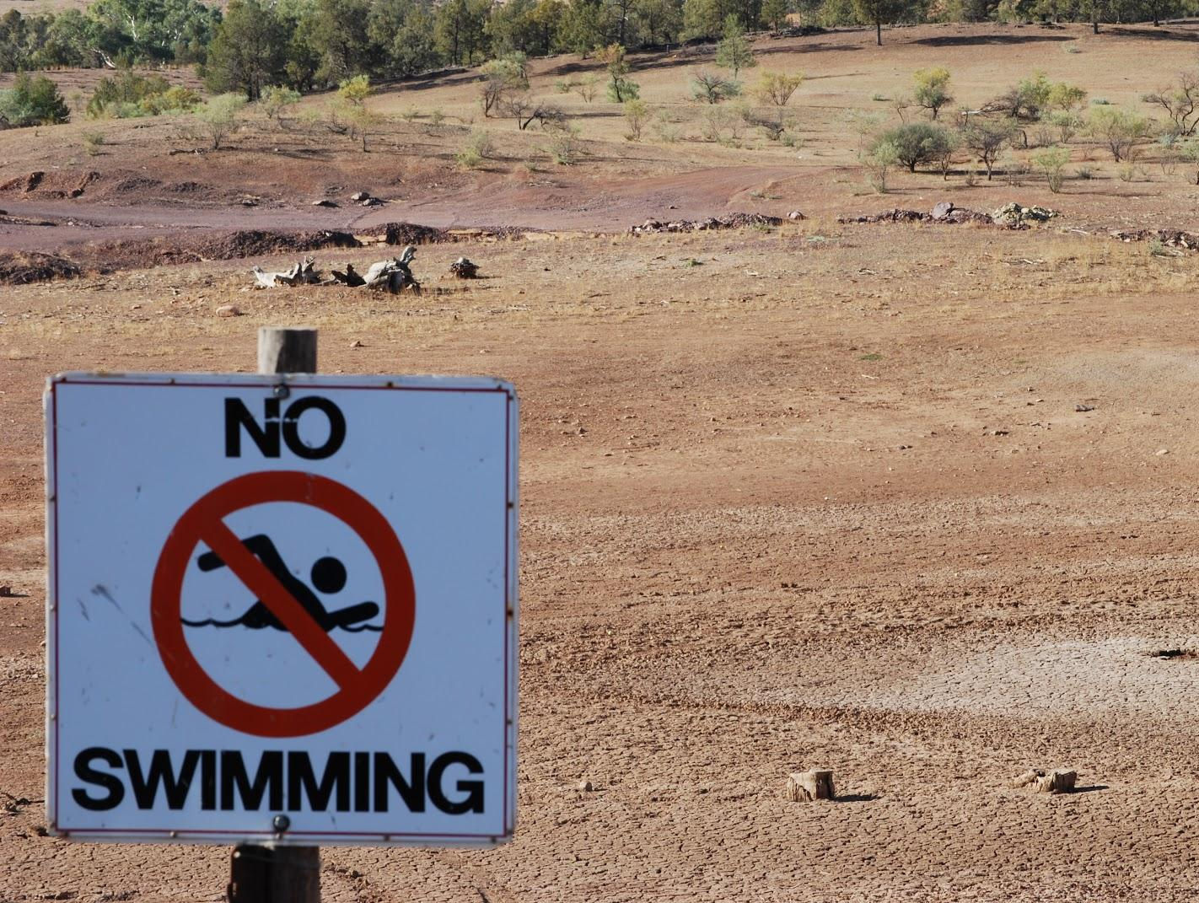
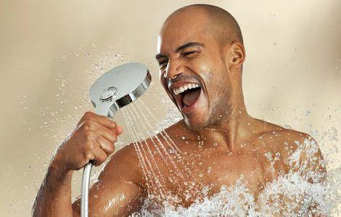
The Problem

Slide 4
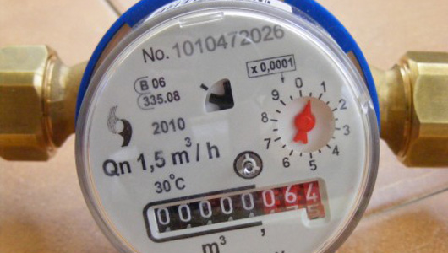
Can you read this…?

Slide 5
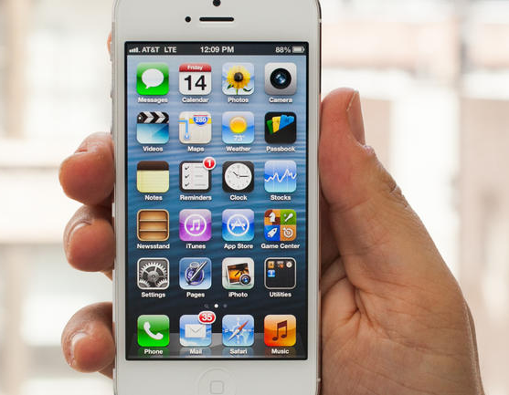
The solution lies in H₂OW _{low} !

Slide 6
Contextual Inquiry Description
How do people use water?
Are they interested in conservation?
If so, are they engaged in it?
What motivates/discourages them?
How much do they know about their water usage?

Slide 7
Who we recruited
Students
They are our primary target group!
Recruited on campus/graduate residence.

Slide 8
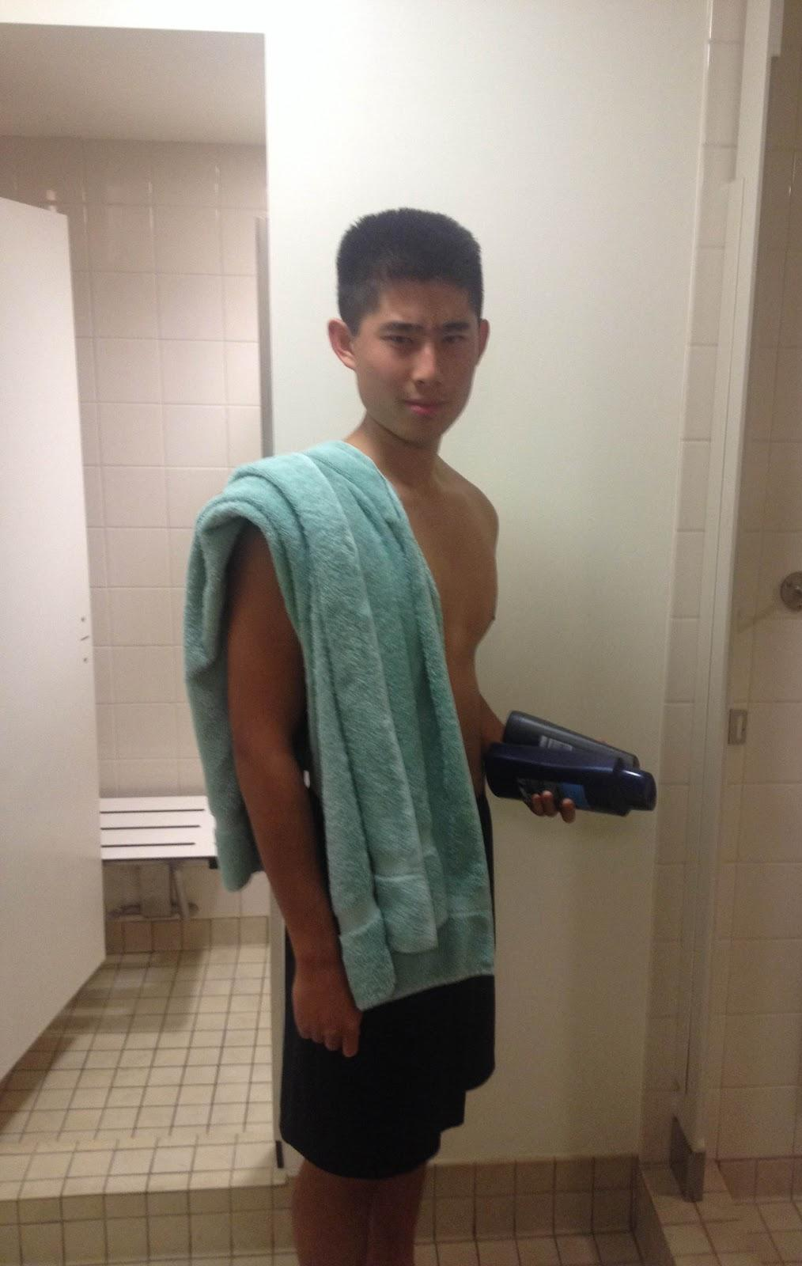
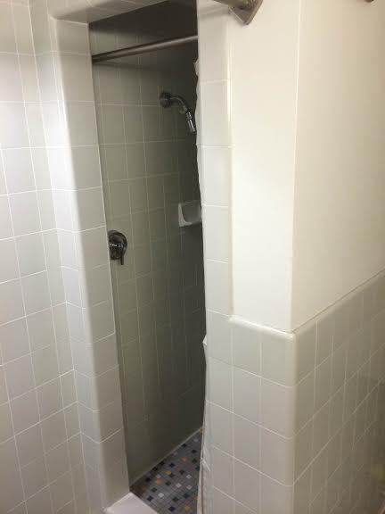
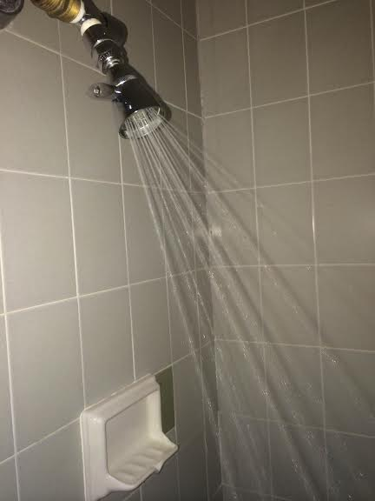
Tasks

Slide 9
Contextual Inquiry Results
“I am not above the average!”
Can’t quantify water use.
response: “5 gallons for a shower”
- Anonymous consumption/lack of accountability.

Slide 10
Task Analysis
Who will use the system?
Groups such as students / families / work colleagues
What tasks do they perform?
Evaluate their personal water consumption
What tasks are desired?
Sustainable use

Slide 11
Task Analysis
How are tasks learned?
Competition / constant reinforcement
Where are the tasks performed?
Hopefully everywhere!
Relationship between customer & data?
Currently 0! e.g 5 gallons / shower
Water bill (0.0025$/gallon)

Slide 12
Task Analysis
What other tools do customers have?
Manual entry
Requires active checking
No incentives
How do users communicate w each other
Currently THEY DON’T!
Live competitive tracking / chat function

Slide 13
Task Analysis
How often are tasks performed?
Multiple times daily
What are the time constraints?
Until the event finishes
What happens when things go wrong?
Lose competition
Global drought, sad times

Slide 14
3 Representative Tasks
simple:
automatically import water usage data
moderate:
make conservation a competition
complex:
allow cities to collect data about population water usage patterns

Slide 15
3 Application Ideas
Competition
Significance: medium (less long term)
Feasibility: high (easy to do between dorms)
Interest: high (students are competitive, possibly prize incentives)

Slide 16
3 Application Ideas
Charity
Significance: high (helps people in need)
Feasibility: medium (deals with charities)
Interest: high (support good cause)

Slide 17
3 Application Ideas
Education
Significance: high (true goal is long term behavioral change)
Feasibility: high (regular factlets pop up)
Interest: low (requires regular checking)

Slide 18
Our top choice
Combats the two problems uncovered through contextual inquiry:
lack of accountability
no motivation
Makes data collection painless and automatic
comprehensive, integrated in the home, easy

Slide 19
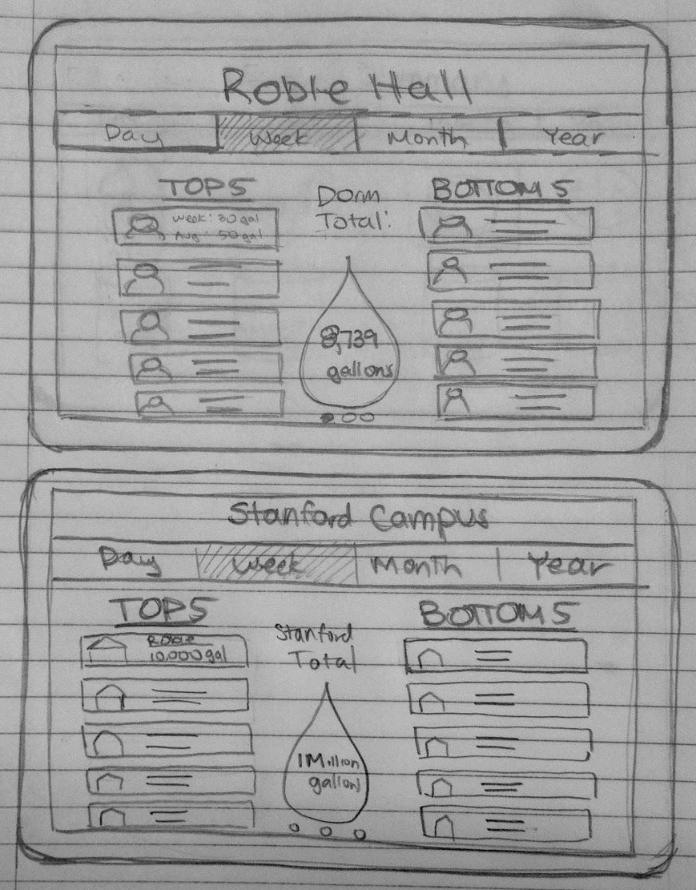

Slide 20
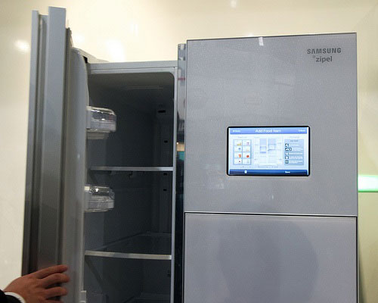
Refrigerator display

Slide 21
Zoomed in

Slide 22
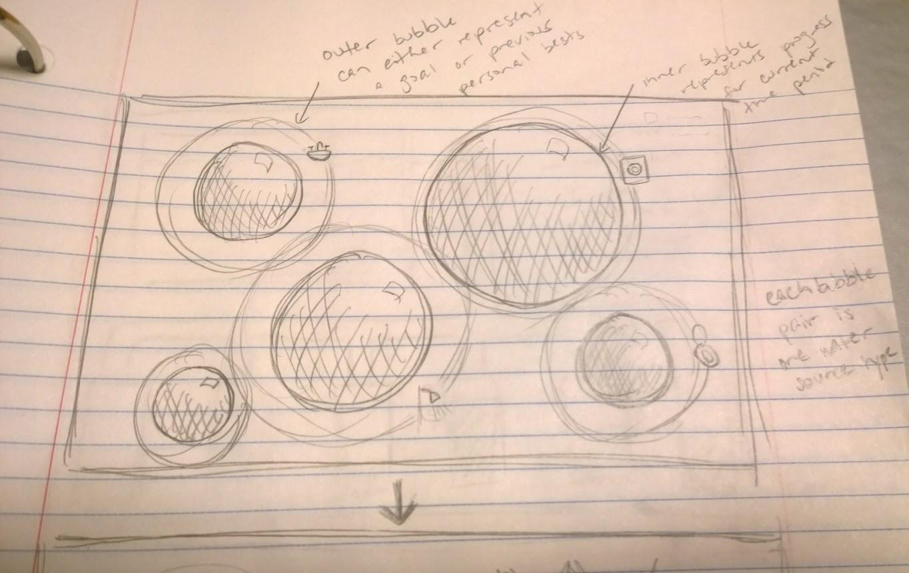
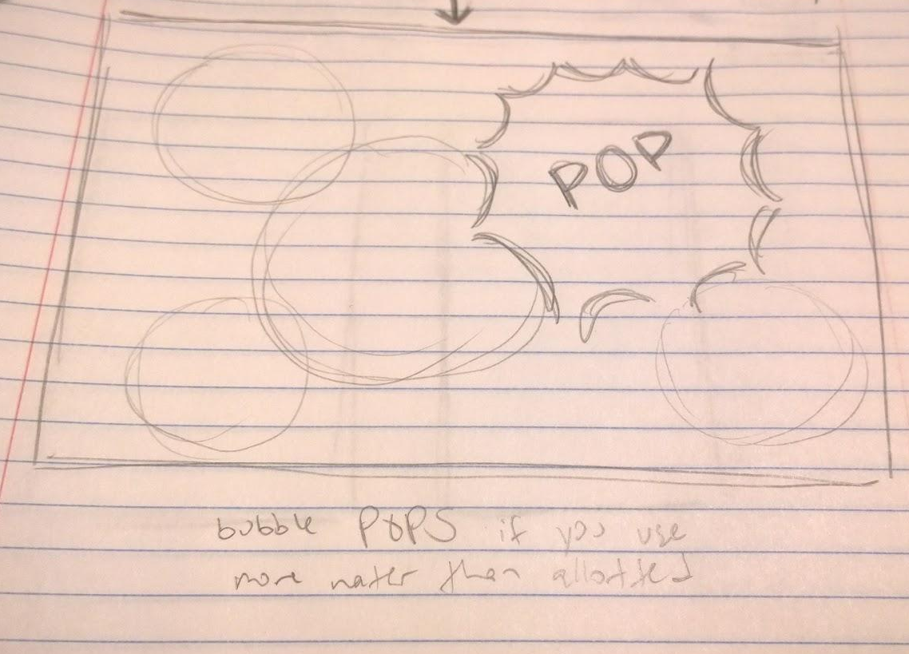
Other examples

Slide 23
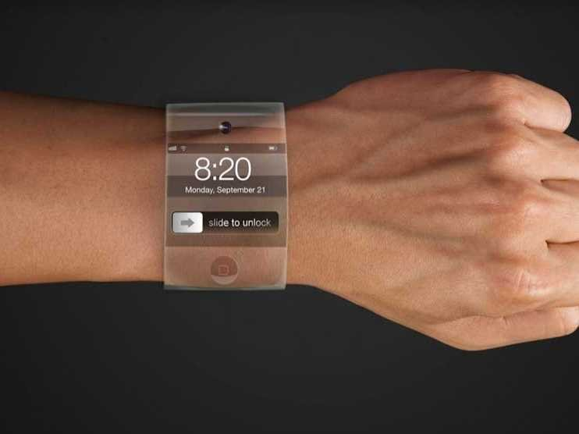
Wearable

Slide 24
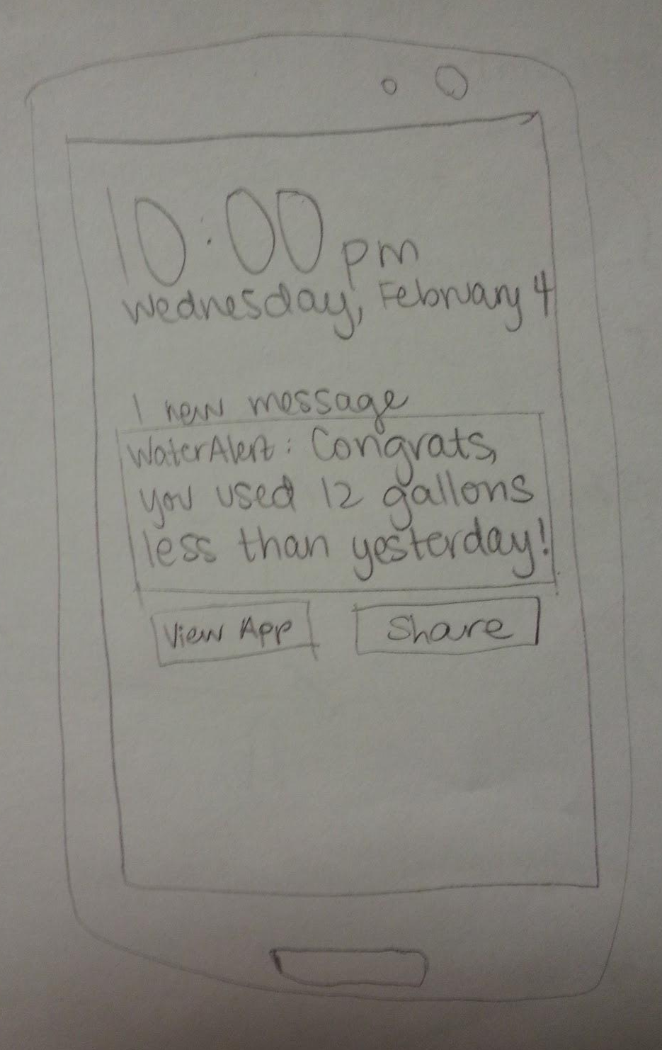
Phone apps

Slide 25
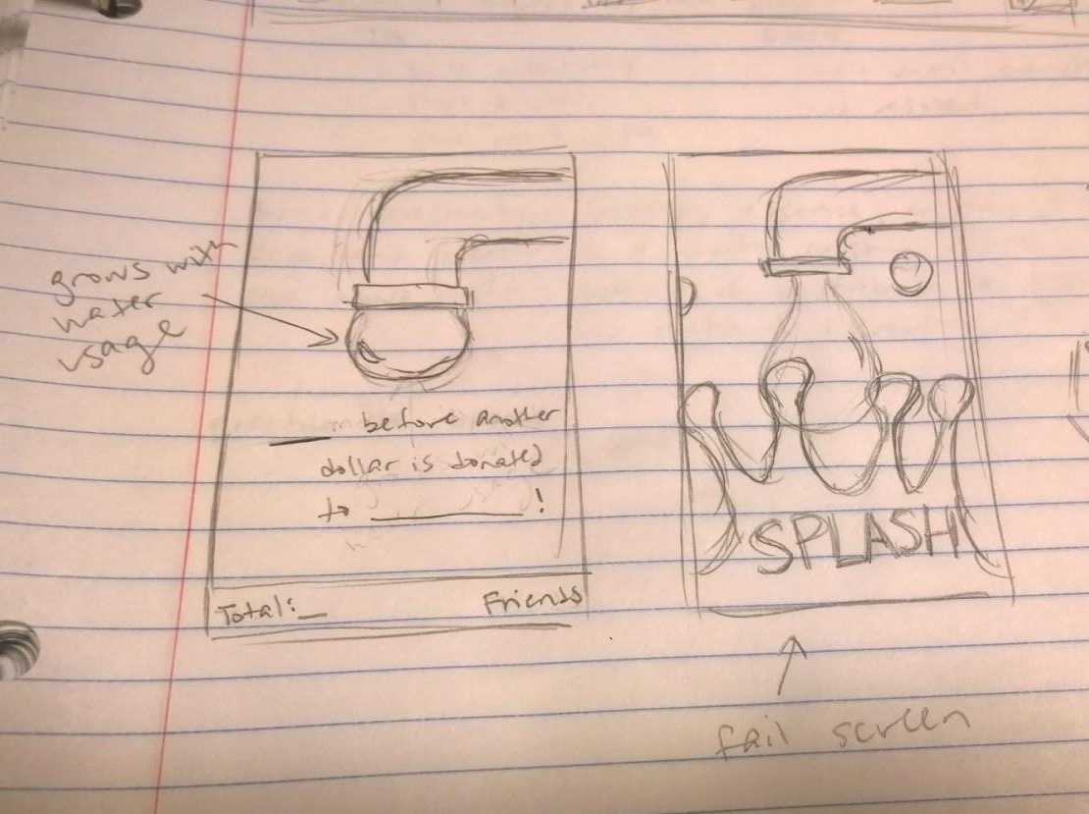
Other examples

Slide 26
Summary
Comprehensive in-residence system
Automatically tracks water use
Set personal and residence goals
Compare performance to others!
“Moisture is the essence of wetness, and wetness is the essence of beauty.” - Derek Zoolander

